Slide 1

Introducing the TV Show Tracker App
By: Jake Shammas

Slide 2
Why I Made This Project
It helped me practice working with structured data (such as storing shows, episodes, and statuses)
I was inspired to make an App that is easy for beginner show watchers to enjoy and connect to
I've always had a passion for TV, and I felt personally connected to this topic
I've never seen anything like this personally and the idea of making a simple easy to use system to track your progress and recommend similar shows was a very cool idea
Its all built from scratch with Java and JavaFX which made me more confident in my ability to do this again in the future

Slide 3
Classes and OOP Structure
User(model)
What it does: Represents a person using the app, it stores the shows that they are watching
Main features: Add shows, Updates how many episodes they have watched

Slide 4
TVShow (model)
What it does: Represents the tv shows information such as the title, genre, # of episodes, and how many have been watched.
Main features: Track how many episodes are left, show the info on the screen in a clear way.

Slide 5
DatabaseHandler/ RecommendationEngine (Util)
What they do: DatabaseHandler keeps the information stored for the next time the app is opened, and the RecommendationEngine suggests show types based on the genre inputted such as “Drama” or “Comedy”
Main Features: Saving Data and Recommending Similar Shows

Slide 6
TVShowTrackerGUI (App)
What it does: Allows user to interact with the main screen of the app allowing inputs all through textboxes and buttons.
Main features: Easy-to-use interface for adding and updating shows, shows user progress through a show, displays genre-based recommendations.

Slide 7
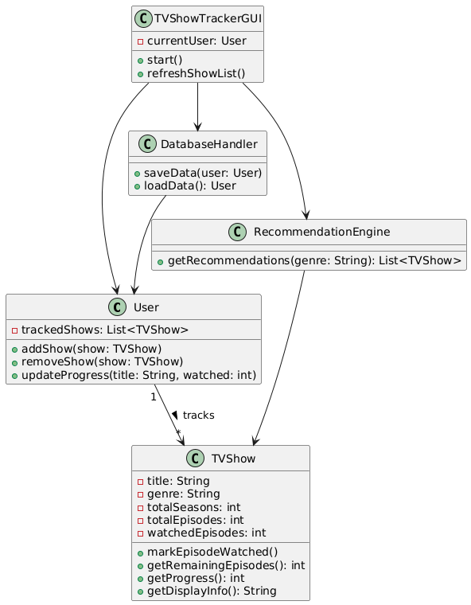
UML Class Diagram

Slide 8
System Design and UML Classes
Understanding the Relationships
User-> Tracks multiple TVShow objects
TVShowTrackerGUI-> interacts with User, DatabaseHandler, and RecommendationEngine to manage data and provide recommendations
Database Handler-> Saves/Loads user data
RecommendationEngine-> Provides show suggestions based on genre

Slide 9
Live Demo!
https://www.youtube.com/shorts/X6kH2zrjbLI

Slide 10
What I Learned!
I was able to learn more about the object-oriented programming basics
1
I learned how to design classes that help track progress of watching a TV show and gives recommendations based on the genre that they enjoy.
2
I learned how to make an app using JavaFX that lets a user interact with adding shows, updating progress, and giving recommendations
3
I learned how to make UML class diagrams that helped me structure what my code would ultimately do in the end
4

